Slide 1
RStudioServer
How to set up a RStudioServer
Objective : execute code on distant machine

Slide 2




Architecture
Internet Gateway
RStudio
Public instance
Public subnet

Slide 3
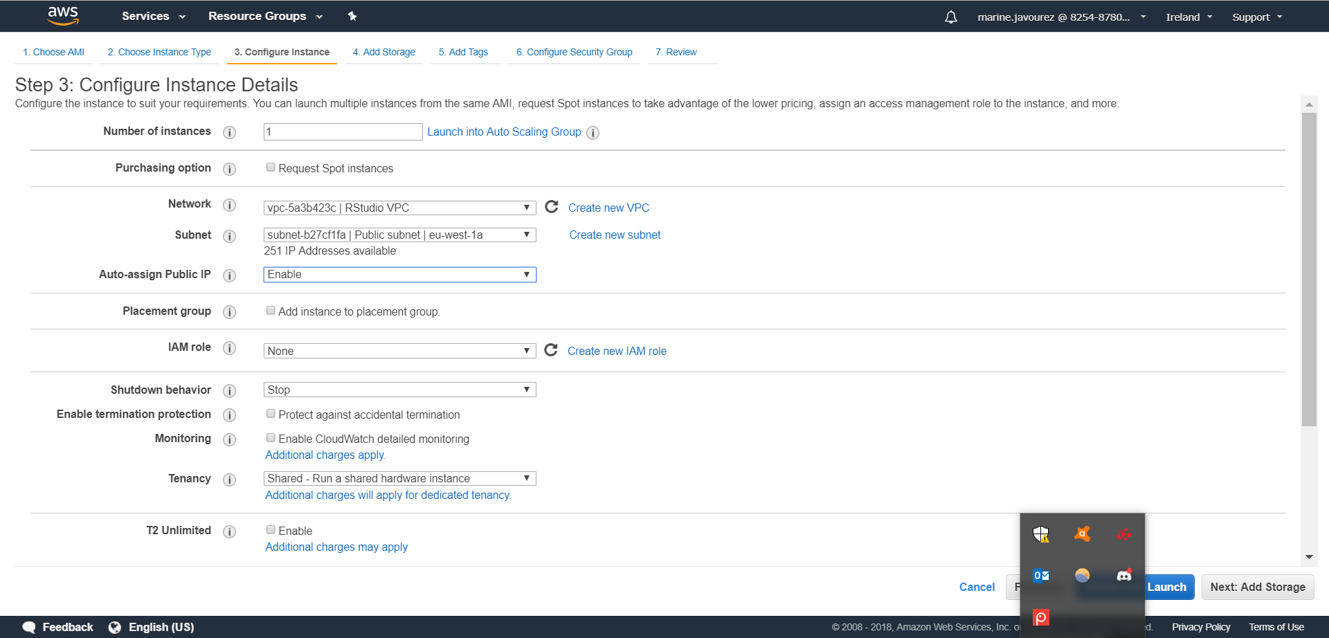
EC2 < Launch Instance
Choose and select instance
Choose a VPC and a public subnet
Choose Enable

Slide 4
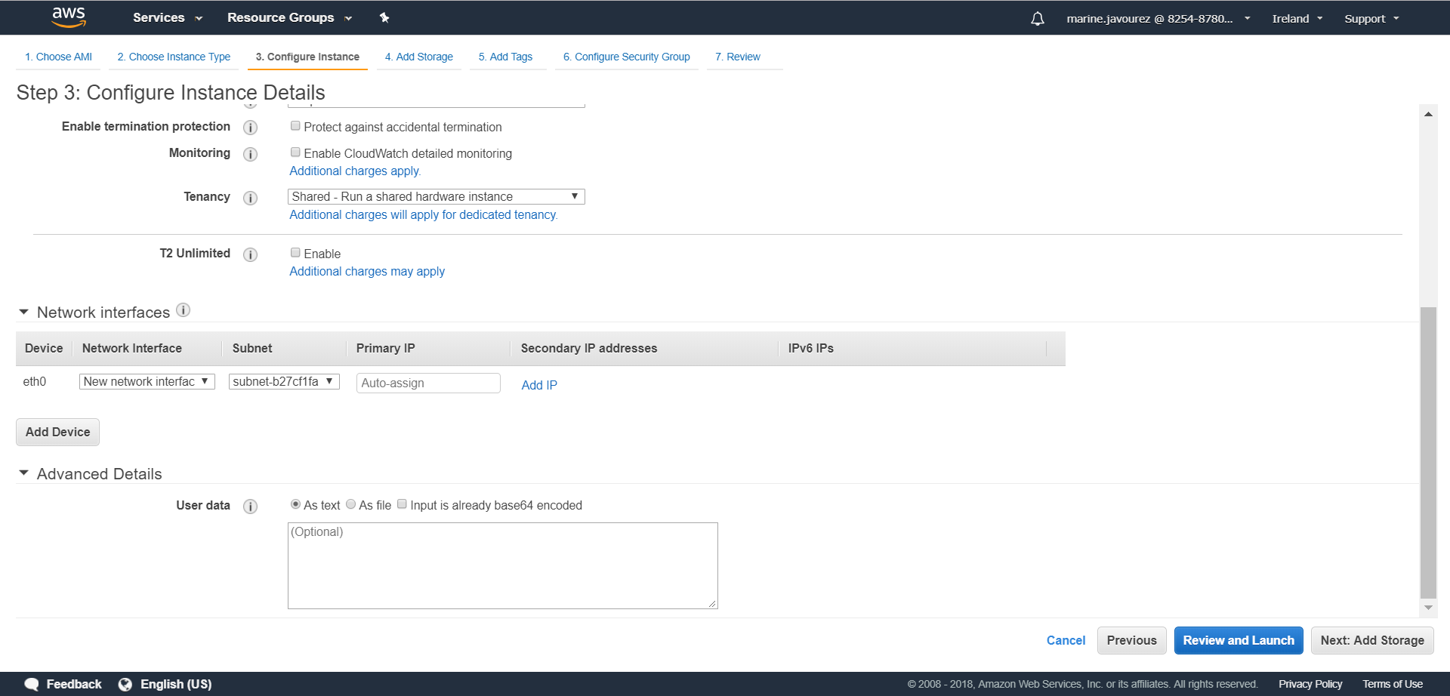
In Advanced Details, insert the text following

Slide 5
Text to copy past
#!/bin/bash
#Update the package manager
#Yum in this case as it is ran on Amazon Linux
sudo yum update -y
#Install R
sudo yum install -y R
#Install RStudio-Server
#https://www.rstudio.com/products/rstudio/download-server/
wget https://download2.rstudio.org/rstudio-server-rhel-1.1.383-x86_64.rpm
sudo yum install -y --nogpgcheck rstudio-server-rhel-1.1.383-x86_64.rpm
sudo rm rstudio-server-rhel-1.1.383-x86_64.rpm
#Install shiny and shiny-server
sudo R -e "install.packages('shiny', repos='http://cran.rstudio.com/')"
wget https://download3.rstudio.org/centos5.9/x86_64/shiny-server-1.5.5.872-rh5-x86_64.rpm
sudo yum install -y --nogpgcheck shiny-server-1.5.5.872-rh5-x86_64.rpm
sudo rm shiny-server-1.5.5.872-rh5-x86_64.rpm
#add user(s)
sudo useradd username
echo username:password | sudo chpasswd
Change username
Change password

Slide 6
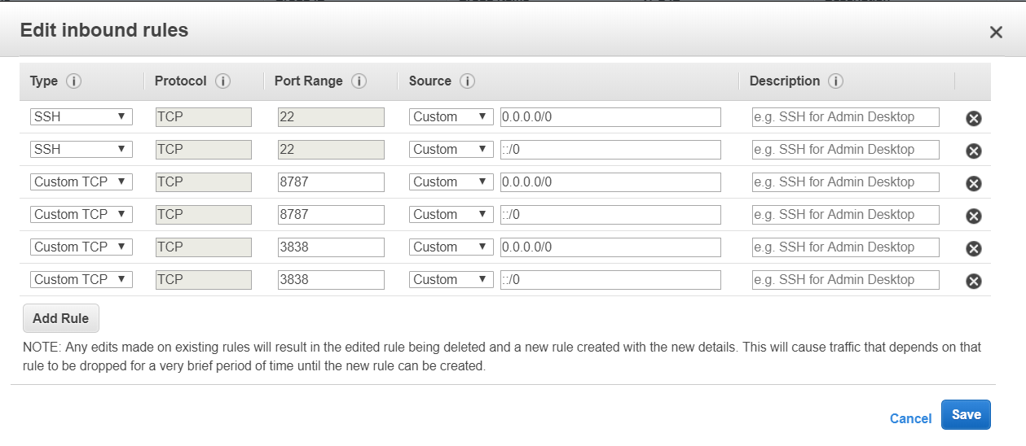
Review and Launch
Choose a key pair
Go to Security Group
Select the security group
Inbound > Edit
Open access to Shiny Server

Slide 7
Open your navigator
Copy-paste the public IP address : port 8787
Ex: 10.0.0.0:8787
Enter username and password
To import files :
In the command line :
scp –i « file.pem » file.pem ec2-user@/*IP address ex : 10.0.0.0 */:.
To see what has happened at launch, you can check the user data output in the following file:
/var/log/cloud-init-output.log
Allow to send file
File to transfer
Authentication key
Destination
Folder

Slide 8
To configure Shiny Server :
Once the Server Shiny is set up, a little configuration is needed. Connect to the instance and launch the following command lines:
mkdir ~/ShinyApps
sudo /opt/shiny-server/bin/deploy-example user-dirs
cp -R /opt/shiny-server/samples/sample-apps/hello ~/ShinyApps/
To check if it works :
http://YOU_IP:3838/ec2-user/hello/

